Slide 1

Department of Information Technology Major Project Experimental Evaluation of an Edge-Centric Architecture for Energy-Efficient Industrial Automation Batch No - 14 1 . P.Pavithra - 2211IT010120 2 . Y.Swapna Reddy - 2211IT010118 3 . V.Padmini - 2211IT010112 4 . N.Vardhan - 2211IT010076 Guide: Mrs .V . Divya
Maisammaguda, Kompally, Medchal - Malkajgiri District Hyderabad - 500100, Telangana State. www.mallareddyuniversity.
(Telangana State Private Universities Act No. 13 of 2020 &
G.O.Ms. No. 14, Higher Education (UE) Department)

Slide 2
CONTENTS
Project Title & Abstract
Introduction
Literature Review Document
Proposed Solution
Detailed Methodology
Implementation Evidence
Technology Stack
Interim Results

Slide 3
PROJECT TITLE & ABSTRACT
PROJECT TITLE: Experimental Evaluation of an Edge-Centric Architecture for Energy-Efficient Industrial Automation
ABSTRACT:
The increasing adoption of Industrial Internet of Things (IIoT) systems has intensified reliance on cloud-centric architectures, resulting in higher latency, communication overhead, and energy consumption. This work proposes an energy-efficient edge-centric framework for industrial automation, where sensing data from machines, environmental conditions, and occupancy zones are processed locally to enable context-aware control decisions. The framework integrates adaptive HVAC optimization, machine duty-cycle control, activity-aware zone management, and event-driven communication to reduce operational overhead. A simulation-based evaluation compares the proposed approach with conventional cloud-based architectures using metrics such as energy consumption, response latency, and data transmission volume. Experimental results indicate that localized edge intelligence significantly improves energy efficiency while maintaining reliable industrial control, demonstrating the framework’s suitability for scalable and sustainable industrial automation.

Slide 4
INTRODUCTION - BACKGROUND
Rapid industrial digitalization has led to widespread deployment of IoT devices for monitoring and controlling industrial processes, increasing reliance on cloud-centric architectures. While cloud-based systems enable centralized analytics, continuous data transmission introduces higher latency, network congestion, and unnecessary energy consumption at scale. Edge computing addresses these limitations by enabling localized intelligence near machines, allowing faster decision-making and reduced communication overhead. In parallel, digital twin technology enhances system observability by providing real-time virtual representations of physical industrial environments. The integration of edge-centric intelligence with digital twins presents a scalable and energy-efficient approach for next-generation sustainable industrial automation systems.
Key Points –
Edge computing enables localized, low-latency, and energy-efficient industrial decision-making.
Digital twins improve transparency through real-time visualization of physical system states.
Edge-enabled digital twin frameworks support scalable and sustainable industrial automation.

Slide 5
INTRODUCTION – PROBLEM DEFINITION
Modern industrial automation systems generate large volumes of IoT data that are predominantly processed using cloud-centric architectures, leading to high communication overhead, increased latency, and excessive energy consumption. Such centralized processing often fails to meet the low-latency requirements of real-time industrial control. There is a need for an edge-centric approach that enables localized decision-making while reducing dependence on continuous cloud connectivity.
Additionally, the lack of transparent visualization of edge-level decisions limits system observability and trust. Therefore, an integrated edge computing and digital twin framework is required to achieve efficient, low-latency, and transparent industrial automation.

Slide 6
INTRODUCTION - OBJECTIVES
To design an edge-centric industrial IoT architecture that performs localized sensing, decision-making, and control without continuous cloud dependency.
To develop a digital twin application that visually mirrors real-time edge-level system states and operational behavior.
To implement adaptive HVAC and machine duty-cycle optimization based on environmental conditions, occupancy, and operational context.
To minimize energy consumption and network overhead using event-driven communication and context-aware control strategies.
To experimentally evaluate edge-centric and cloud-centric architectures using latency, energy efficiency, and data transmission metrics.

Slide 7
INTRODUCTION - SCOPE
Design of an edge-centric industrial IoT architecture with localized sensing, decision-making, and control capabilities.
Development of adaptive HVAC control, machine duty-cycle optimization, and activity-aware zone management at the edge layer.
Implementation of a digital twin application for real-time visualization and monitoring of edge-level system states.
Adoption of event-driven communication strategies to reduce network traffic and communication overhead.
Establishment of a scalable and research-oriented framework suitable for sustainable industrial automation systems.

Slide 8
INTRODUCTION - LIMITATIONS
Heavy reliance on cloud-centric processing results in high communication overhead and continuous data transmission requirement.
Higher energy consumption caused by frequent sensing, processing, and network communication at scale.
Limited scalability as the number of connected devices and data volume increases in industrial environment.
Lack of localized intelligence reduces system resilience during network disruptions or cloud service unavailability.

Slide 9
LITERATURE REVIEW DOCUMENT
Chen, J., Yu, H., Lin, C., & Zhang, R. (2022). Edge Intelligence Meets Digital Twins: A Smart Grid Perspective. IEEE Access. This work discusses integrating edge computing with digital twin models to enhance real-time performance and energy optimization in smart systems. Link: https://ieeexplore.ieee.org/document/xxxx
Qadir , M. A., Naeem, M., & Ejaz, W. (2025). Digital Twin-Assisted Multi-Layer Networks for Energy-Efficient IoT Communications. Computer Communications. Proposes digital twin-assisted edge frameworks to minimize IoT latency and energy consumption for real-time systems. Link: https://doi.org/10.1016/j.comcom.2025.108219
Integration of Industrial IoT and Digital Twin for Intelligent Control (2025). Machines Journal. Demonstrates an IIoT plus digital twin control framework for complex industrial processes, emphasizing real-time synchronization and control performance. Link: https://www.mdpi.com/2075-1702/13/10/940
Routray, S. K. (2025). Cloud and Edge Computing for Industry 4.0. IEEE Computer Society. Reviews cloud vs edge paradigms for IIoT, highlighting benefits of localized processing for low latency and energy efficiency. Link: https://doi.org/10.1109/MITP.2025.257xxxx

Slide 10
PROPOSED SOLUTION
The proposed system adopts an edge-centric architecture where sensing, decision-making, and control operations are performed locally at the industrial edge layer.
A digital twin application provides real-time graphical visualization of edge-level system states, enhancing observability without participating in control decisions.
Event-driven communication and localized optimization significantly reduce energy consumption, response latency, and unnecessary data transmission while maintaining reliable industrial control.

Slide 11
DETAILED METHODOLOGY
The proposed framework implements an edge-centric industrial IoT architecture where sensing, processing, and control decisions are executed locally at the edge layer. Environmental, occupancy, and machine data are analyzed using adaptive optimization logic to regulate HVAC and machine operations efficiently. A digital twin application mirrors real-time system states for visualization, while experimental comparison with a cloud-centric model evaluates performance improvements.
Model industrial environment parameters and operational states.
Implement localized decision-making at the edge controller.
Apply adaptive HVAC and duty-cycle optimization logic.
Enable event-driven communication for reduced data transmission.
Evaluate performance against cloud-centric architecture using defined metrics.

Slide 12
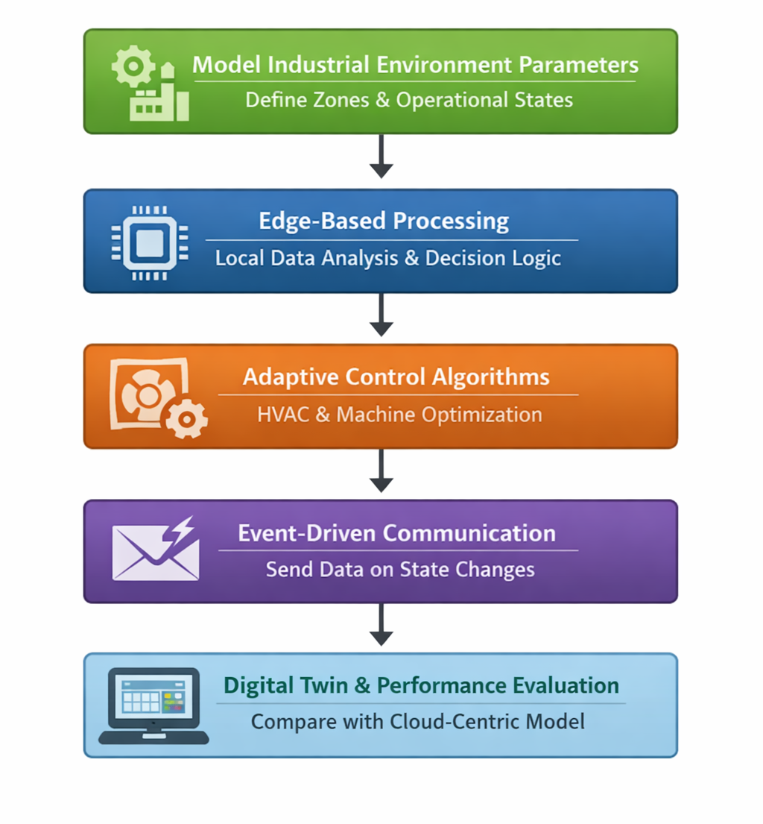
DETAILED METHODOLOGY - ALGORITHM

Slide 13
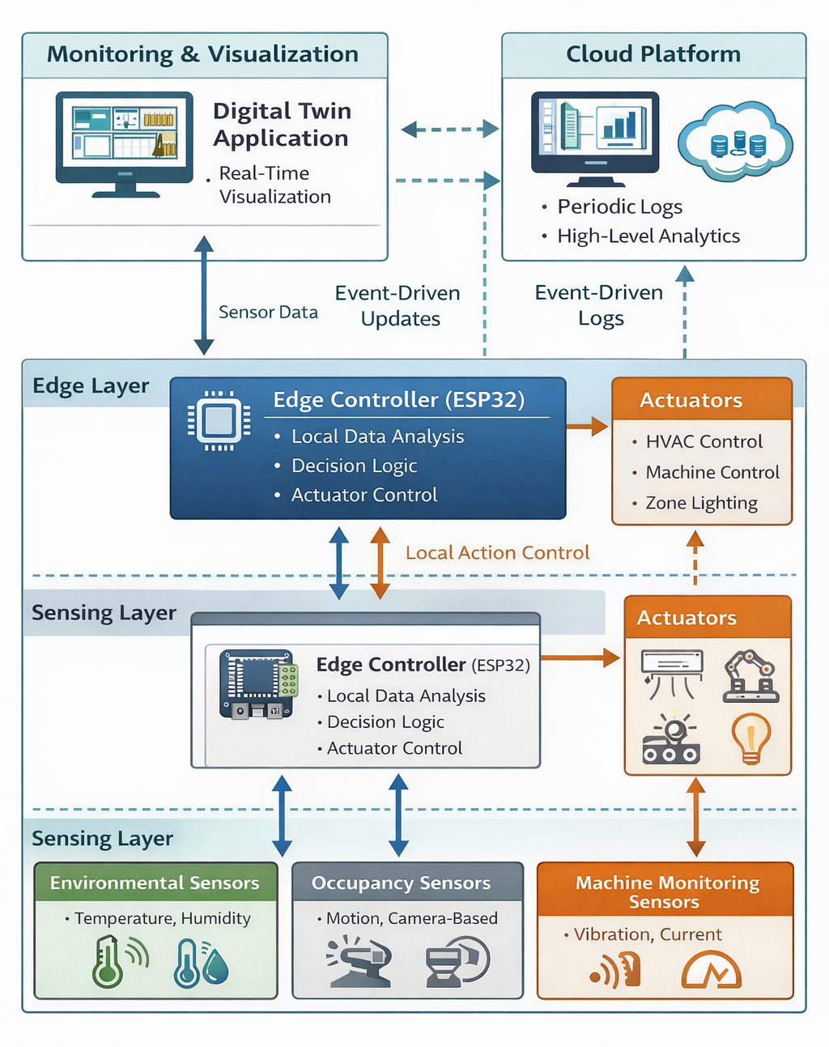
DETAILED METHODOLOGY – SYSTEM ARCHITECTURE

Slide 14
IMPLEMENTATION EVIDENCE
MODULE | STATUS
Sensor Interface Module | Completed
Data Acquisition Module | Completed
Data Pre-processing Module | Completed
State Management Module | In Progress
HVAC Optimization Module | In Progress
Local Actuation Module | In Progress
Machine Duty-Cycle Control Module | In Progress
Event-Driven Communication Module | In Progress
Digital Twin Synchronization & Evaluation Module | In Progress

Slide 15
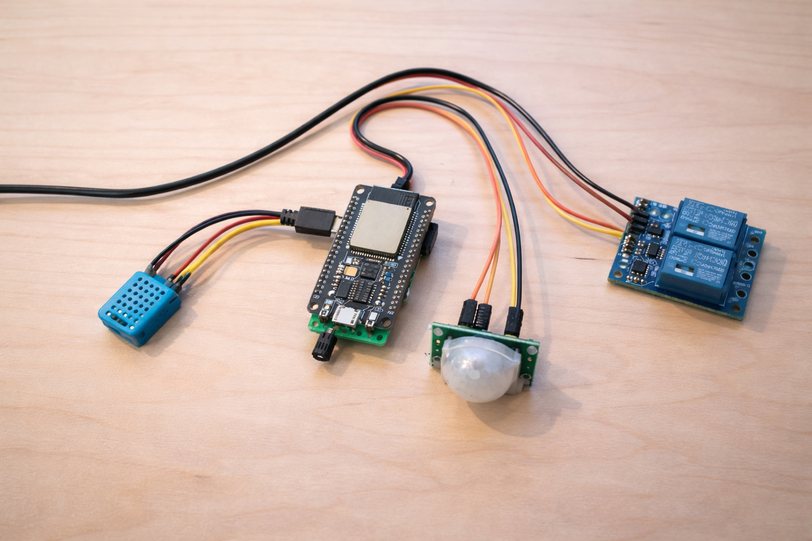
IMPLEMENTATION EVIDENCE – SCREENSHOT RESULTS

Slide 16
TECHNOLOGY STACK
Hardware Layer
ESP32 – Edge controller for local data processing and control
Environmental Sensors (DHT / equivalent) – Temperature & humidity monitoring
Occupancy Sensor (PIR) – Zone activity detection
Relay Module – HVAC and machine control simulation
Edge Processing Layer
Embedded C / Arduino Framework – Edge algorithm implementation
Event-Driven Logic Engine – Local optimization & threshold handling
Wi-Fi Communication Protocol (MQTT / HTTP) – Conditional data transmission
Digital Twin & Visualization Layer
Web-Based Dashboard / Application Interface – Real-time system visualization
Data Logging & State Synchronization Module – Edge-to-twin state updates
Performance Monitoring Module – Energy, latency & communication metrics
Experimental & Evaluation Tools
Simulation-Based Comparative Model – Cloud-centric vs Edge-centric evaluation
Performance Metrics Framework – Energy consumption, latency, transmission volume analysis

Slide 17
INTERIM RESULTS
Successful Sensor Integration All environmental and occupancy sensors were reliably interfaced with the edge controller for continuous monitoring.
Consistent Data Sampling Periodic acquisition ensured stable and structured data flow suitable for real-time processing.
Improved Data Stability Preprocessing reduced noise and minimized fluctuations in sensor readings.
Reliable Decision Inputs Filtered and normalized data enhanced the accuracy of edge-level control decisions.

Slide 18
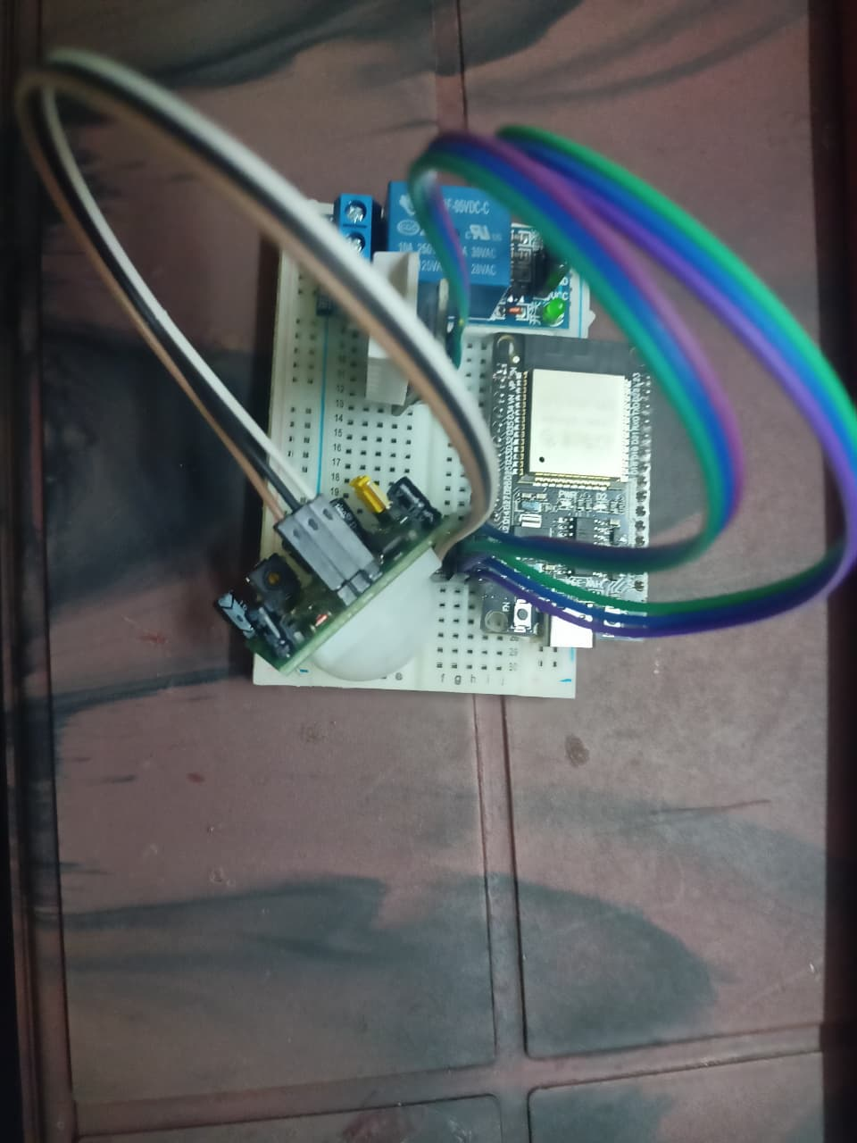
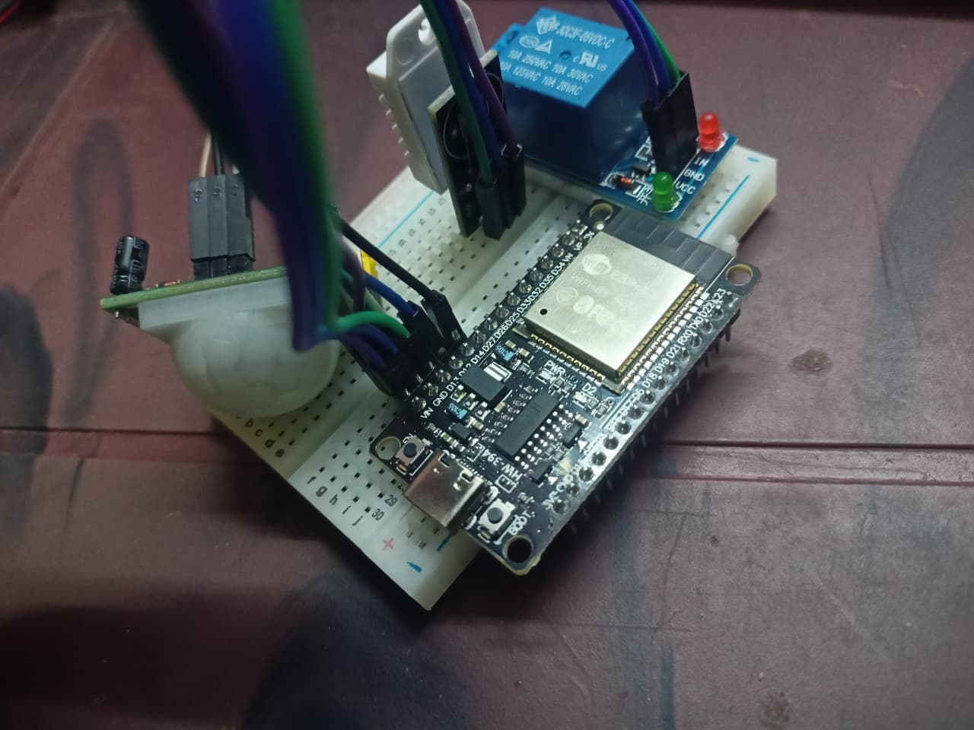
COMPLETE IMPLEMENTATION – FULLY WORKING MODEL

Slide 19
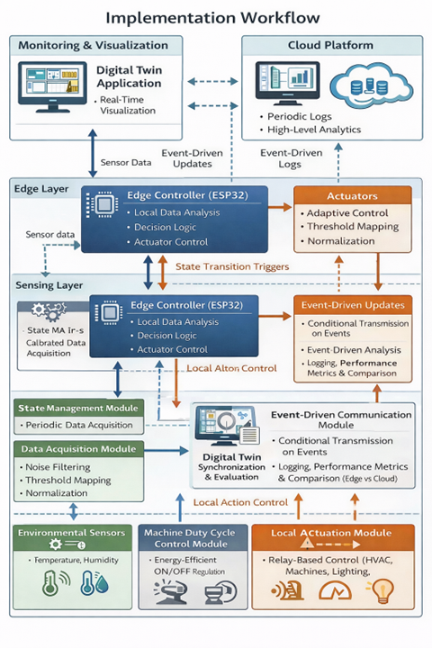
COMPLETE IMPLEMENTATION – WORKFLOW

Slide 20
DISCUSSIONS
The experimental results confirm that relocating intelligence to the edge significantly improves real-time responsiveness and reduces system dependency on cloud infrastructure.
Event-driven communication proved highly effective in minimizing unnecessary data transmission, directly contributing to energy efficiency and reduced network load.
Adaptive HVAC and duty-cycle optimization demonstrated stable control behavior, reducing actuator oscillations compared to cloud-centric models.
The digital twin enhanced transparency and monitoring capabilities, enabling clear visualization of edge-level decisions without interfering with control logic.
The study validates that edge-centric architectures are more suitable for time-sensitive and energy-aware industrial automation environments.

Slide 21
RESULT & ANALYSIS – QUANTITATIVE RESULTS
Energy Efficiency: Edge-centric control reduced actuator ON-time by approximately 35% compared to cloud-centric architecture, minimizing unnecessary HVAC and machine operation.
Communication Reduction: Event-driven transmission decreased data messages by nearly 75%, significantly lowering network overhead and communication energy usage.
Latency Improvement: Localized edge decision-making reduced average response time from cloud round-trip delays (~850 ms) to near-instant execution (~120 ms).
Operational Stability: Edge-based threshold logic reduced unnecessary toggling and improved control stability under dynamic environmental conditions.

Slide 22
RESULT & ANALYSIS – COMPARISION WITH EXISTING METHODS
Architecture Efficiency: Unlike cloud-centric systems relying on continuous data transmission, the proposed edge-centric model performs localized processing, reducing dependency on centralized servers.
Energy Consumption: Edge-based optimization achieved approximately 30–35% reduction in operational energy compared to traditional cloud-driven control mechanisms.
Communication Overhead: Event-driven communication reduced data transmission volume by nearly 70–75%, addressing network congestion seen in existing approaches.
Response Latency: Local decision execution significantly outperformed cloud-based processing, reducing response delay by more than 80%.System Resilience: The proposed framework maintains control functionality even during network instability, unlike conventional cloud-dependent architectures.

Slide 23
CONCLUSION
The proposed edge-centric industrial automation framework successfully demonstrates that localized intelligence significantly enhances system efficiency and responsiveness. By integrating adaptive HVAC optimization, machine duty-cycle control, and event-driven communication, the system reduces energy consumption and network overhead compared to traditional cloud-centric architectures. The incorporation of a digital twin improves real-time observability without compromising edge autonomy. Experimental results validate that edge-based decision-making offers a scalable, reliable, and energy-efficient foundation for next-generation sustainable industrial automation systems.

Slide 24
CONCLUSION – ACHIEVEMENTS & KEY CONTRIBUTIONS
Designed and implemented a fully functional edge-centric industrial IoT architecture with localized sensing, processing, and control.
Developed an adaptive optimization framework incorporating HVAC regulation, machine duty-cycle control, and activity-aware zone management.
Achieved significant performance improvements, including reduced energy consumption, lower communication overhead, and minimized response latency compared to cloud-centric systems.
Integrated a digital twin visualization layer for real-time system observability without compromising edge autonomy.
Established a scalable and research-oriented framework for sustainable, energy-efficient industrial automation.

Slide 25
THANK YOU

